Slide 1
CuDNN in MagmaDNN

Slide 2
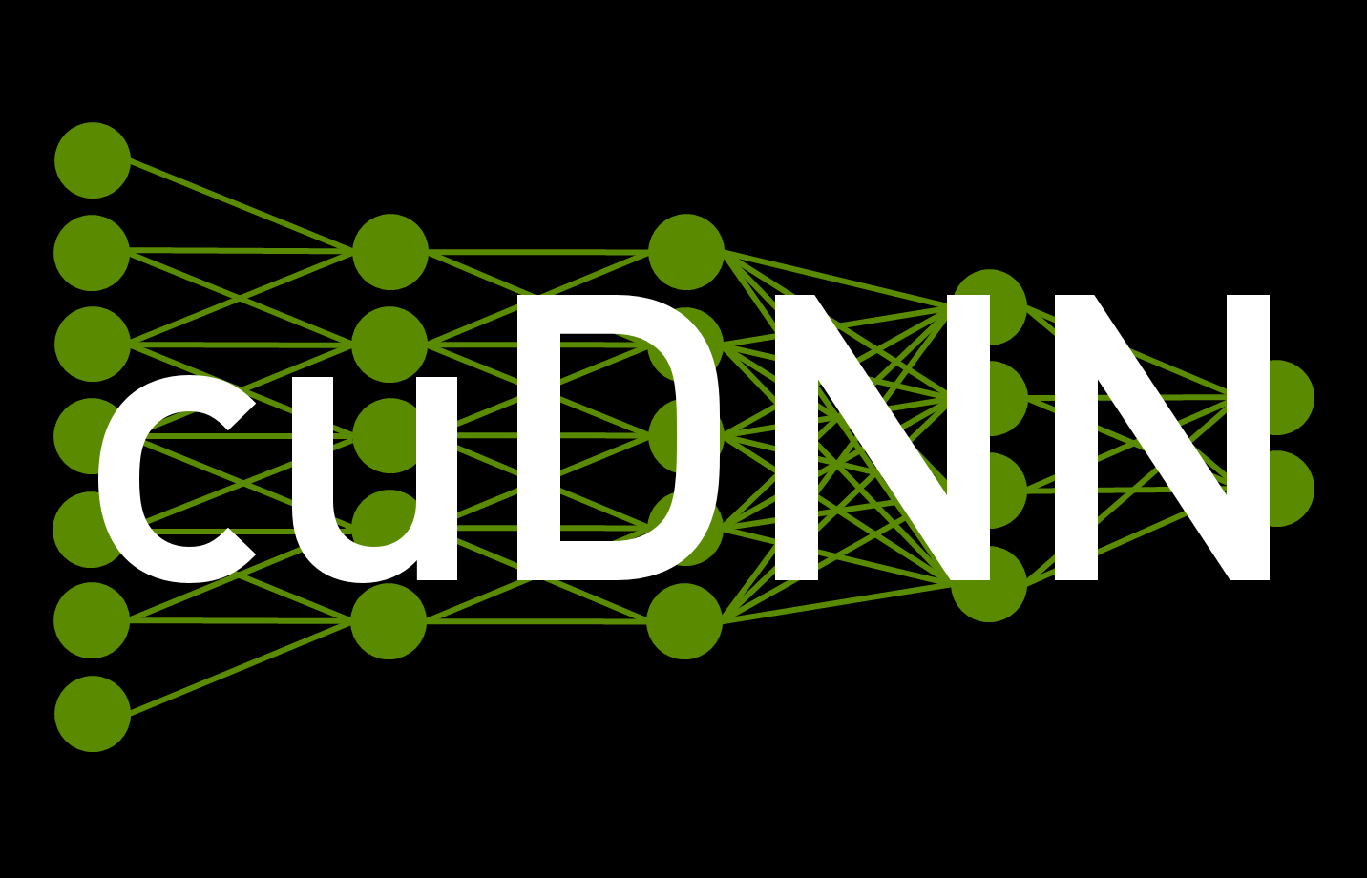
CuDNN
CUDA Deep Neural Network Library, or CuDNN is a GPU-accelerated library for deep neural networks.
it is built upon the CUDA framework and acts as the building blocks for a machine learning framework.
CuDNN provides highly tuned implementations for
Convolution layers
Pooling, Activation, Batchnorm layers
RNN layers
By keeping the API low level, CuDNN can be easily implemented in other frameworks.

Slide 3
CuDNN in MagmaDNN: Convolution
Basic programming flow is very straightforward and consists mainly of
defining all the data and parameters as well as allocating the memory on the gpu for all the data
calling to forward pass with all the allocated data
calling the backward pass if training a neural network
free the memory

Slide 4

CuDNN in MagmaDNN: Convolution
To run anything in cudnn, we have to first create a cudnn_handle type which is done automatically when magmadnn begins
Then we initialize the data and parameters such as:
cudnnTensorDescriptor_t, describe the tensors storing the data
cudnnFilterDescriptor_t, describes the filter for the convolution
cudnnConvolutionDescriptor_t, describes convolution parameters/structure
cudnnConvolutionFwdAlgo_t, describes the convolution algorithm used
as well as the data and parameters needed for the backwards path, which are basically the same
cudnnConvolutionBwdDataAlgo_t describes the algorithms that CuDNN will use in the backwards
cudnnConvolutionBwdFilterAlgo_t path

Slide 5
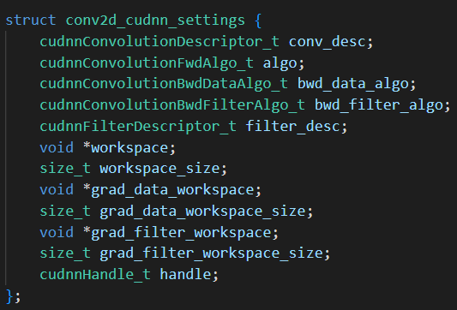

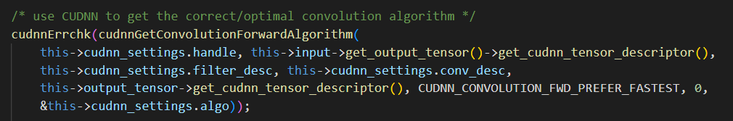
CuDNN in MagmaDNN: Convolution
This shows the structure that is used to describe the convolution layers
the variables inside are initialized using the functions that cudnn provides

Slide 6
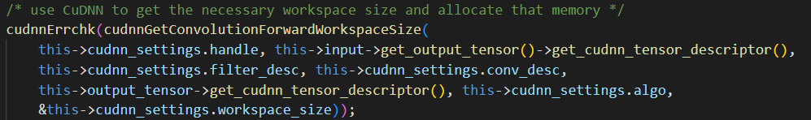
CuDNN in MagmaDNN: Convolution
The data is then passed into a function “cudnnGetConvolutionForwardWorkspaceSize” where cudnn will calculate the physical memory size needed to run the process.
After that, we malloc the memory and then call the “cudnnConvolutionForward” function, which will complete the forwards pass and return the output in the “out->get_ptr()” pointer location

Slide 7
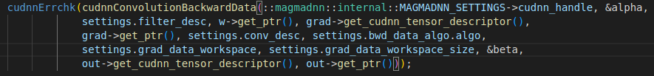
CuDNN in MagmaDNN: Convolution
For the backward pass, the process is fairly similar to the forward pass, but the functions are just changed to the backward version.

Slide 8
LSTM in MagmaDNN
The setup and execution for the LSTM using CuDNN is similar to Convolution
The main differences are the RNN specific parameters and functions
cudnnRNNDescriptor_t, Describes structure of the RNN
cudnnRNNAlgo_t, Describes RNN algorithm
cudnnRNNMode_t, Describes cell mode (in this case LSTM)
cudnnRNNBiasMode_t, Specifies number of bias matrices

Slide 9



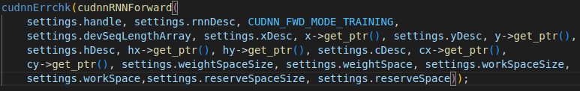
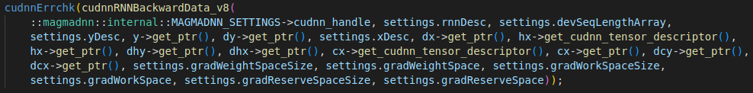
LSTM Code Snippets

